Slide 1
OBJECT RELAtIONal MAPPING (ORM)
ORM is a tool for storing data from domain objects to relational database like MS SQL Server, in an automated way, without much programming
Programming technique for converting data between incompatible type systems in OOP languages. This creates, in effect, a "virtual object database" that can be used from within the programming language
maps your database directly with C# objects

Slide 2
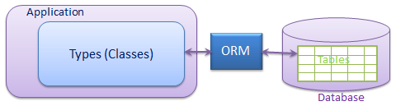

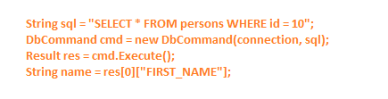
0rm

Slide 3
Orm
Includes 3 parts:
Domain class objects
Relational database objects
Mapping information - on how domain objects map to relational database objects (tables, views & stored procedures)

Slide 4
ORM
Implementation-specific details of storage drivers are generally wrapped in an API in the programming language in use – LINQ
Reduces the amount of code that needs to be written
It automates standard CRUD operation (Create, Read, Update & Delete)

Slide 5
Some ORM FRAMEWORKS
ENTITY FRAMEWORK
NHIBERNATE
DAPPER
SUBSONIC
ENTERPRISE LIBRARY
etc

Slide 6
Entity framework

Slide 7
Entity framework
(ORM) framework that enables developers to work with relational data as domain-specific objects, eliminating the need for most of the data access plumbing code that developers usually need to write
Developers issue queries using LINQ, then retrieve and manipulate data as strongly typed objects all you need to write
It is an enhancement to ADO.NET that gives developers an automated mechanism for accessing & storing the data in the database.

Slide 8
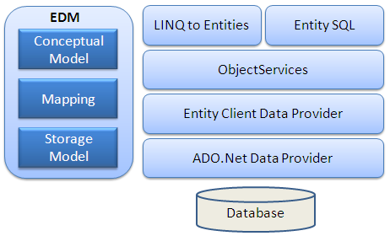
EF- ARCHITECTURE

Slide 9
EF- ARCHITECTURE
EDM (Entity Data Model): EDM consists of three main parts - Conceptual model, Mapping and Storage model.
Conceptual Model: The conceptual model contains the model classes and their relationships. This will be independent from your database table design.
Storage Model: Storage model is the database design model which includes tables, views, stored procedures, and their relationships and keys.
Mapping: Mapping consists of information about how the conceptual model is mapped to the storage model.
LINQ to Entities: LINQ to Entities is a query language used to write queries against the object model. It returns entities, which are defined in the conceptual model. You can use your LINQ skills here.
Entity SQL: Entity SQL is another query language just like LINQ to Entities. However, it is a little more difficult than L2E and the developer will have to learn it separately.
Object Service:Object service is a main entry point for accessing data from the database and to return it back. Object service is responsible for materialization, which is the process of converting data returned from an entity client data provider (next layer) to an entity object structure.
Entity Client Data Provider:The main responsibility of this layer is to convert L2E or Entity SQL queries into a SQL query which is understood by the underlying database. It communicates with the ADO.Net data provider which in turn sends or retrieves data from the database.
ADO.Net Data Provider:This layer communicates with the database using standard ADO.Net.

Slide 10
EF – SETUP ENVIRONMENT

Slide 11
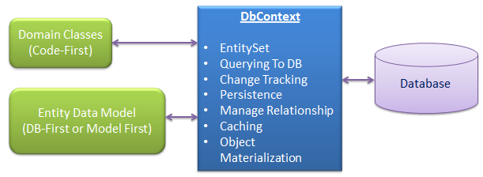
EF – DBCONTEXT CLASS
System.Data.Entity.DbContext

Slide 12
EF – DBCONTEXT CLASS
EntitySet: DbContext contains entity set (DbSet<TEntity>) for all the entities which is mapped to DB tables.
Querying: DbContext converts LINQ-to-Entities queries to SQL query and send it to the database.
Change Tracking: It keeps track of changes that occurred in the entities after it has been querying from the database.
Persisting Data: It also performs the Insert, Update and Delete operations to the database, based on what the entity states.
Caching: DbContext does first level caching by default. It stores the entities which have been retrieved during the life time of a context class.
Manage Relationship: DbContext also manages relationship using CSDL, MSL and SSDL in DB-First or Model-First approach or using fluent API in Code-First approach.
Object Materialization: DbContext converts raw table data into entity objects.

Slide 13
EF – DBSET CLASS
DBSet class represents an entity set that is used for create, read, update, and delete operations
A generic version of DBSet (DbSet<TEntity>) can be used when the type of entity is not known at build time.
You can get the reference of DBSet by using DBContext, eg. dbcontext.Students, dbcontext.Standards,
Some of the important methods of DBSet class are Add, Find, Remove, etc

Slide 14
Entity life cycle
During an entity's lifetime, each entity has an entity state based on the operation performed on it via the context (DbContext). The entity state is an enum of type System.Data.Entity.EntityState that includes the following values:
Added
Deleted
Modified
Unchanged
Detached

Slide 15
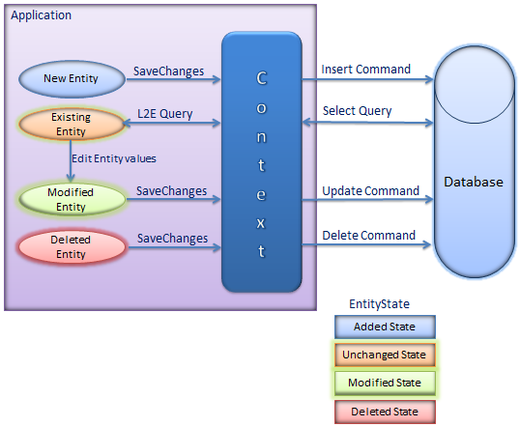
Entity life cycle

Slide 16
EF- APPROCHES
CODE-FIRST
DATABASE FIRST
MODEL FIRST

Slide 17
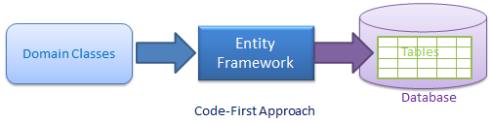
EF – APPROCHES - CODE-FIRST

Slide 18
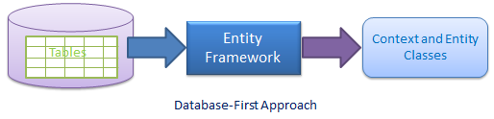
EF – APPROCHES - DATABASE-FIRST

Slide 19
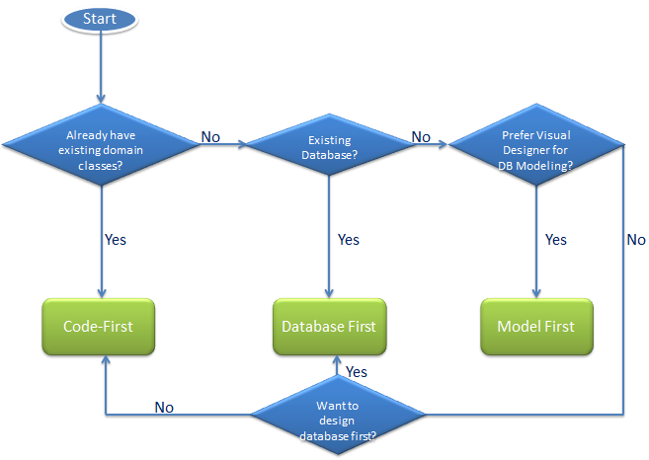
EF-APPROCHES-WHICH ONE YOU CHOOSE

Slide 20
Thank you for now

